Slide 1

Decision Tree

Slide 2
Introduction
A decision tree is a supervised learning algorithm
It is used for classification and regression modeling
Developed in the early 1960s, decision trees are primarily used in data mining, machine learning and statistics.
it’s a flowchart structure where different nodes indicate conditions, rules, outcomes and classes
It is a tree-structured classifier, where internal nodes represent the features of a dataset, branches represent the decision rules and each leaf node represents the outcome.

Slide 3
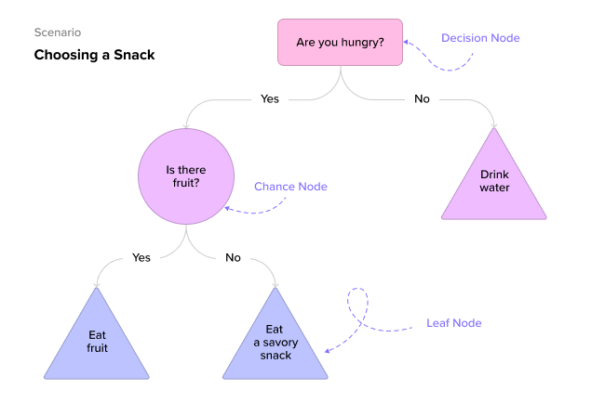
Decision Tree Examples

Slide 4
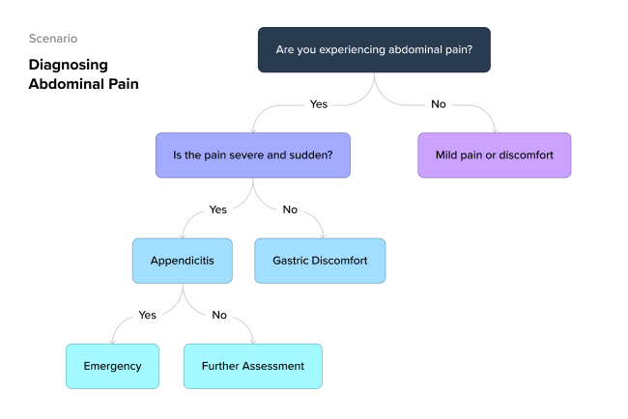

Slide 5
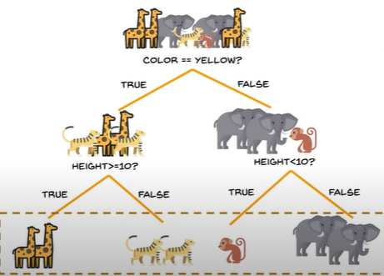

Slide 6
Decision tree terminology
Root node
The topmost node of a decision tree that represents the entire message or decision
Decision (or internal) node
A node within a decision tree where the prior node branches into two or more variables
Leaf (or terminal) node
The leaf node is also called the external node or terminal node, which means it has no child—it’s the last node in the decision tree and furthest from the root node

Slide 7
sub-tree or branch
It contains multiple internal nodes and potentially some leaf nodes depending on the specific branch in question.
Splitting
The process of dividing a node into two or more nodes. It’s the part at which the decision branches off into variables
Pruning
The opposite of splitting, the process of going through and reducing the tree to only the most important nodes or outcomes

Slide 8


Slide 9
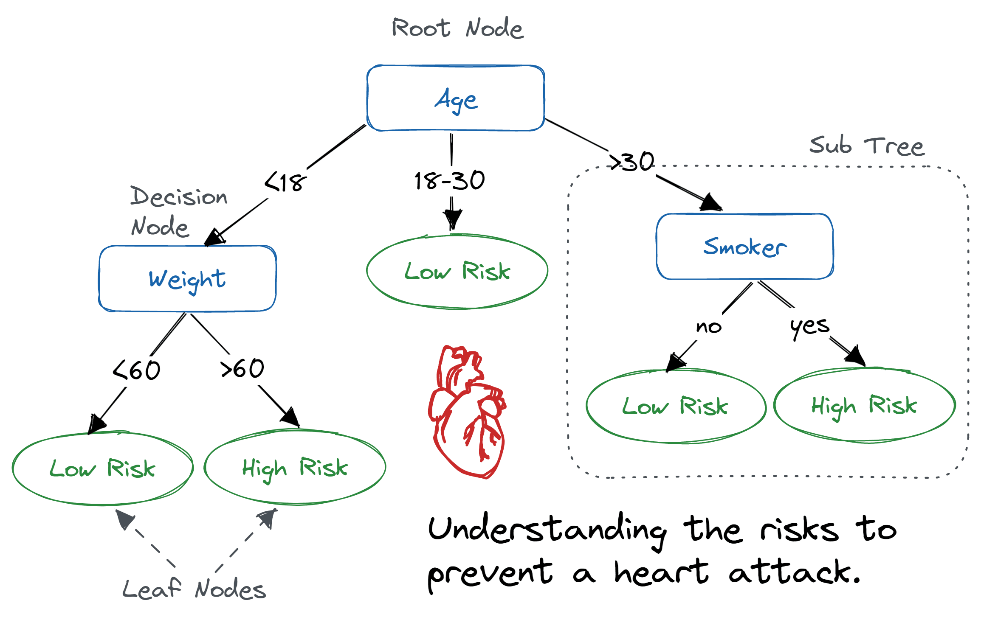

Slide 10
Attribute Selection Measures
While implementing a Decision tree, we must select the best attribute for the root node and for sub-nodes.
So, to solve such problems there is a technique which is called as Attribute selection measure or ASM
there are two popular techniques for ASM, which are:
Information Gain
Gini Index

Slide 11
Entropy
It specifies randomness in data.
Entropy is a metric to measure the impurity in a given attribute
Entropy(s)= -P(yes)log2 P(yes)- P(no) log2 P(no)
Where,
S= Total number of samples
P(yes)= probability of yes
P(no)= probability of no

Slide 12
Information Gain
Information gain is the measurement of changes in entropy after the segmentation of a dataset based on an attribute.
It calculates how much information a feature provides us about a class.
According to the value of information gain, we split the node and build the decision tree.
A decision tree algorithm always tries to maximize the value of information gain, and a node/attribute having the highest information gain is split first.
Constructing a decision tree is all about finding attribute that returns the highest information gain

Slide 13
Gini Index
Gini index is a measure of impurity or purity used while creating a decision tree in the CART(Classification and Regression Tree) algorithm.
An attribute with the low Gini index should be preferred as compared to the high Gini index.

Slide 14
Types of Decision Tree
Classification tree
Regression tree
Classification tree
Classification trees determine whether an event happened or didn’t happen (yes/no)
Email Spam Detection
Fault Detection in Manufacturing
Image Classification

Slide 15
Regression tree
Regression trees, predict continuous values based on previous data or information sources.
decision-making is more about programming algorithms to predict what is likely to happen, given previous behavior or trends.
Example:
predict whether a customer will purchase eggs (including which type of eggs and at which store)
predict the price of gasoline
predict the price of a house in Kumaripati
predict how many bachelor’s degree students there will be in 2025 at university

Slide 16
How does the Decision Tree algorithm Work?
Step-1: Begin the tree with the root node, says S, which contains the complete dataset.
Step-2: Find the best attribute in the dataset using Attribute Selection Measure (ASM).
Step-3: Divide the S into subsets that contains possible values for the best attributes.
Step-4: Generate the decision tree node, which contains the best attribute.
Step-5: Recursively make new decision trees using the subsets of the dataset created in step -3. Continue this process until a stage is reached where you cannot further classify the nodes and called the final node as a leaf node.

Slide 17
Pruning: Getting an Optimal Decision tree
Pruning is a process of deleting the unnecessary nodes from a tree in order to get the optimal decision tree.
A too-large tree increases the risk of overfitting, and a small tree may not capture all the important features of the dataset.
Therefore, a technique that decreases the size of the learning tree without reducing accuracy is known as Pruning

Slide 18
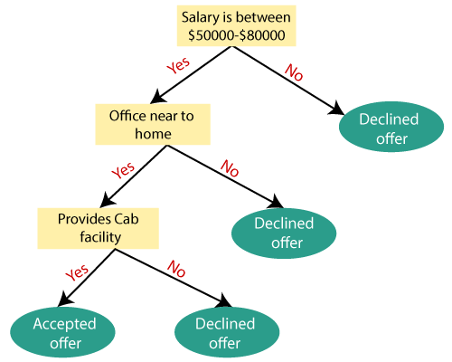

Slide 19
Advantages of the Decision Tree
It is simple to understand as it follows the same process which a human follow while making any decision in real-life.
It can be very useful for solving decision-related problems.
It helps to think about all the possible outcomes for a problem.
There is less requirement of data cleaning compared to other algorithms.

Slide 20
Disadvantages of the Decision Tree
The decision tree contains lots of layers, which makes it complex.
It may have an overfitting issue, which can be resolved using the Random Forest algorithm.
For more class labels, the computational complexity of the decision tree may increase.

